Slide 1
17.OBJECTS IN JAVA
PRESENTED BY S.R.Zameer

Slide 2
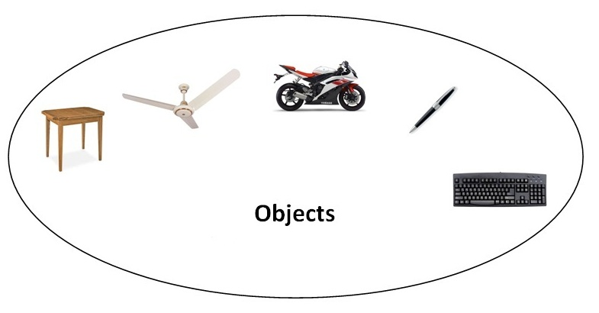
OBJECTS
An entity that has state and behavior is known as an object e.g. chair, bike, marker, pen, table, car etc. It can be physical or logical (tengible and intengible). The example of integible object is banking system.

Slide 3
An object has three characteristics:
state: represents data (value) of an object.
behavior: represents the behavior (functionality) of an object such as deposit, withdraw etc.
identity: Object identity is typically implemented via a unique ID. The value of the ID is not visible to the external user. But, it is used internally by the JVM to identify each object uniquely.
For Example: Pen is an object. Its name is Reynolds, color is white etc. known as its state. It is used to write, so writing is its behavior.

